Slide 1

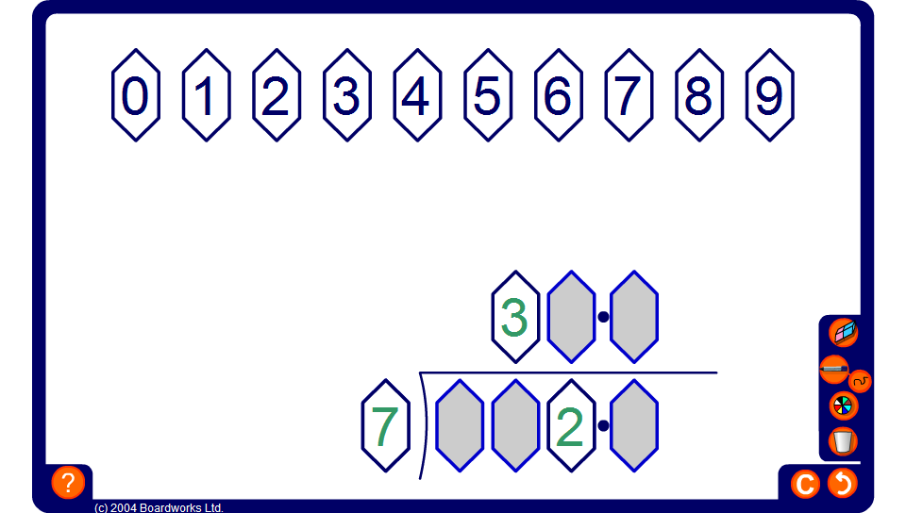


Drag and drop division problem
Notes:
Drag three digits into the short division sum (one digit for each number, say) and ask pupils to fill in the remaining digits to make the sum correct.
Some examples may have more than one possible solution.

